Slide 1

IT5182
Fundamentals of Data Models and Databases
Entity Relationship (ER) Modelling
(Continued)

Slide 2

How Many-to-Many (M:N) relationships are technically implemented

Slide 3

M:N relationships cannot be physically implemented within relational databases (just too complex)
M:N relationships are implemented by introducing a new entity (called an intersection entity) and replacing the M:N with a set of two 1:M relationships
The next few slides explains these ideas

Slide 4

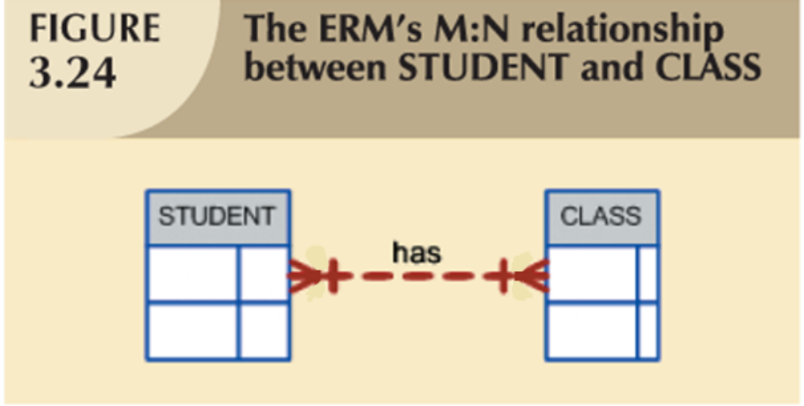
The ERD above shows that a Student has 1 or more Classes and each Class has 1 or more Students. However, there is no way of knowing which Student is in which Class.

Slide 5
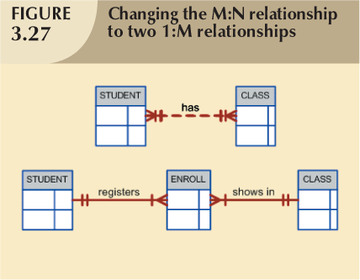
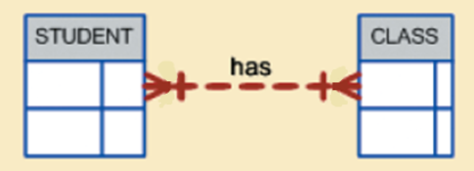
Decomposing M:N Relationships
A new intersection entity (called Enroll in this example) has been added and the original M:N relationship has been replaced by two 1:M relationships placed back-to-back.

Slide 6

The intersection entity (labelled Enroll in the example on previous slide) is used to associate one instance from the Student entity with one instance from the Class entity.
This is achieved by using foreign keys in the intersection entity (see next slide)

Slide 7
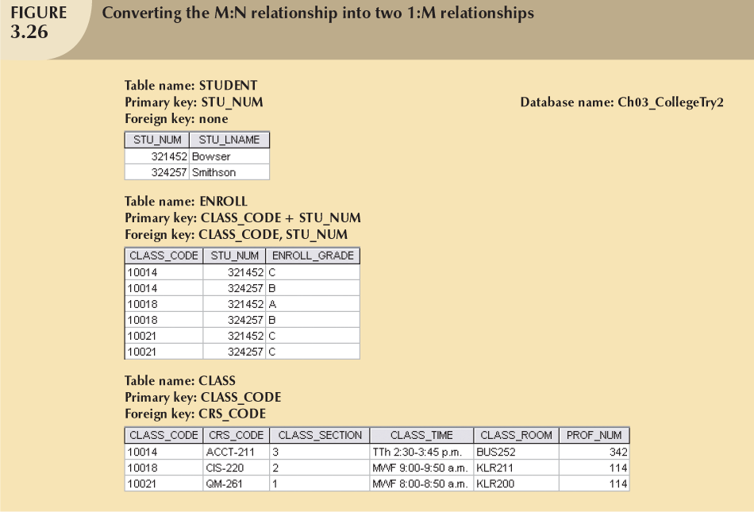

Slide 8
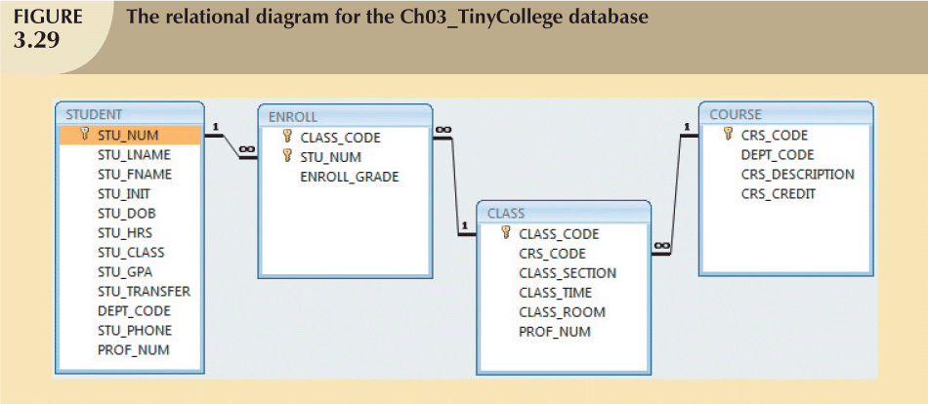

Slide 9

Tables are basic building blocks of a relational database
Keys are central to the use of relational tables
  Primary key
  Foreign key
Each table row must have a primary key that uniquely identifies all attributes
Tables linked by common attributes (using foreign keys)
Good design begins by identifying entities, attributes, and relationships
  1:1, 1:M, M:N

